Slide 1
Mass-Storage Systems

Slide 2
Overview of Mass Storage Structure
Magnetic disks provide bulk of secondary storage of modern computers
Drives rotate at 60 to 250 times per second
Transfer rate is rate at which data flow between drive and computer
Positioning time (random-access time) is time to move disk arm to desired cylinder (seek time) and time for desired sector to rotate under the disk head (rotational latency)
Head crash results from disk head making contact with the disk surface
Notes:
70

Slide 3
Disks
Disks can be removable
Drive attached to computer via I/O bus
Busses vary, including EIDE, ATA, SATA, USB, Fibre Channel, SCSI, SAS, Firewire
Host controller in computer uses bus to talk to disk controller built into drive or storage array

Slide 4
Moving-head Disk Mechanism
Notes:
70

Slide 5
Hard Disk Performance
Access Latency = Average access time = average seek time + average latency
For fastest disk 3ms + 2ms = 5ms
For slow disk 9ms + 5.56ms = 14.56ms
Average I/O time = average access time + (amount to transfer / transfer rate) + controller overhead
For example to transfer a 4KB block on a 7200 RPM disk with a 5ms average seek time, 1Gb/sec transfer rate with a 0.1ms controller overhead =
5ms + 4.17ms + 0.1ms + transfer time =
Transfer time = 4KB / 1Gb/s = 0.031 ms
Average I/O time for 4KB block = 9.27ms + .031ms = 9.301ms

Slide 6
Disk Scheduling
We want fast access time and high disk bandwidth
Minimize seek time
Seek time ≈ seek distance
Disk bandwidth is the total number of bytes transferred, divided by the total time between the first request for service and the completion of the last transfer
Notes:
70

Slide 7
Disk Scheduling (Cont.)
There are many sources of disk I/O request
OS
System processes
Users processes
I/O request includes input or output mode, disk address, memory address, number of sectors to transfer
OS maintains queue of requests, per disk or device
Idle disk can immediately work on I/O request,
Busy disk will queue
Notes:
70

Slide 8
Disk Scheduling (Cont.)
Several algorithms exist to schedule the servicing of disk I/O requests
Example: Assume request queue (0-199 Cyl Nos.)
98, 183, 37, 122, 14, 124, 65, 67
Head pointer 53
Notes:
70

Slide 9
First Come First Served (FCFS)
98, 183, 37, 122, 14, 124, 65, 67
Head pointer 53
Head will first move from 53 to 98, then to 183, 37, 122, 14, 124, 65, and finally to 67, for a total head movement of 640 cylinders

Slide 10
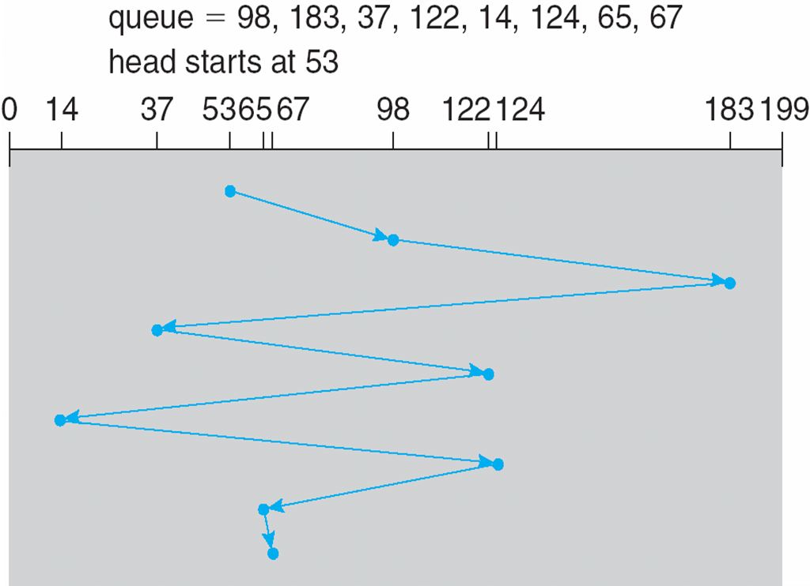
FCFS
Illustration shows total head movement of 640 cylinders
Notes:
70

Slide 11
SSTF
Shortest Seek Time First (SSTF) selects the request with the minimum seek time from the current head position
SSTF scheduling is a form of SJF scheduling; may cause starvation of some requests
98, 183, 37, 122, 14, 124, 65, 67 Head pointer 53
The closest request to the initial head position (53) is at cylinder 65.
Once we are at cylinder 65, the next closest request is at cylinder 67.
From there, the request at cylinder 37 is closer than the one at 98, so 37 is served next.
Notes:
70

Slide 12
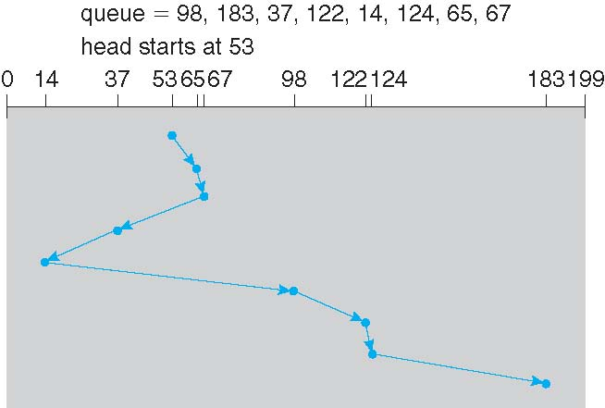
SSTF
Continuing, we service the request at cylinder 14, then 98, 122, 124, and finally 183
This scheduling method results in a total head movement of only 236 cylinders

Slide 13
SCAN
The disk arm starts at one end of the disk, and moves toward the other end, servicing requests until it gets to the other end of the disk, where the head movement is reversed and servicing continues.
SCAN algorithm Sometimes called the elevator algorithm
Illustration shows total head movement of 208 cylinders
If requests are uniformly dense, largest density at other end of disk and those wait the longest
Notes:
70

Slide 14
SCAN
98, 183, 37, 122, 14, 124, 65, 67 Head pointer 53
Assuming that the disk arm is moving toward 0, so the head will next service 37 and then 14.
At cylinder 0, the arm will reverse and will move toward the other end of the disk, servicing the requests at 65, 67, 98, 122, 124, and 183
If a request arrives in the queue just in front of the head, it will be serviced almost immediately; a request arriving just behind the head will have to wait until the arm moves to the end of the disk, reverses direction, and comes back.

Slide 15
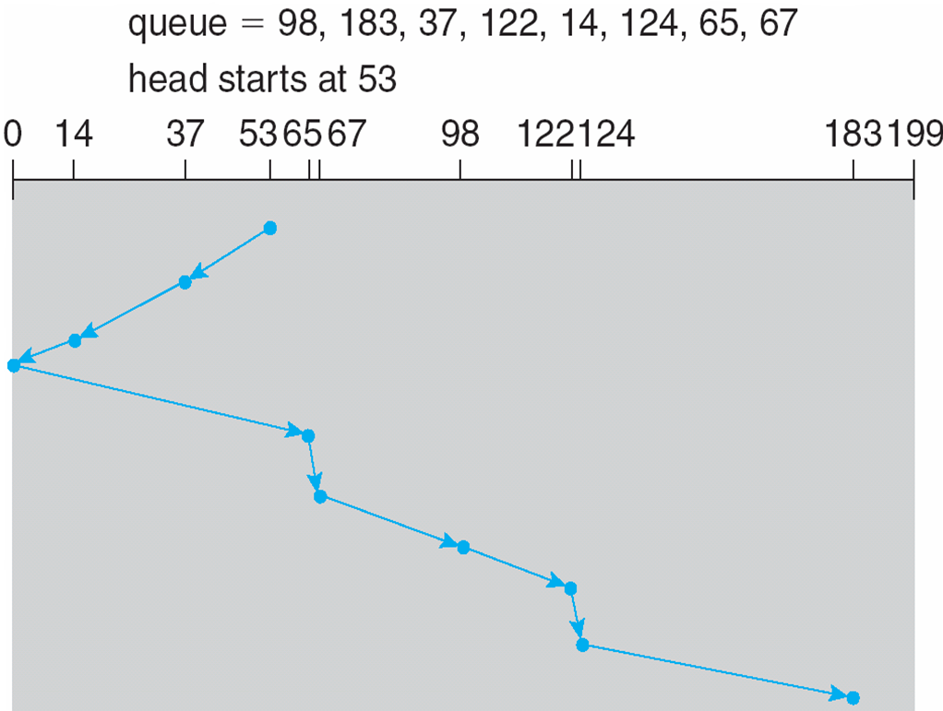
SCAN (Cont.)
Notes:
70

Slide 16
C-SCAN
Circular SCAN
Provides a more uniform wait time than SCAN
The head moves from one end of the disk to the other, servicing requests as it goes
When it reaches the other end, however, it immediately returns to the beginning of the disk, without servicing any requests on the return trip
Treats the cylinders as a circular list that wraps around from the last cylinder to the first one
Notes:
70

Slide 17
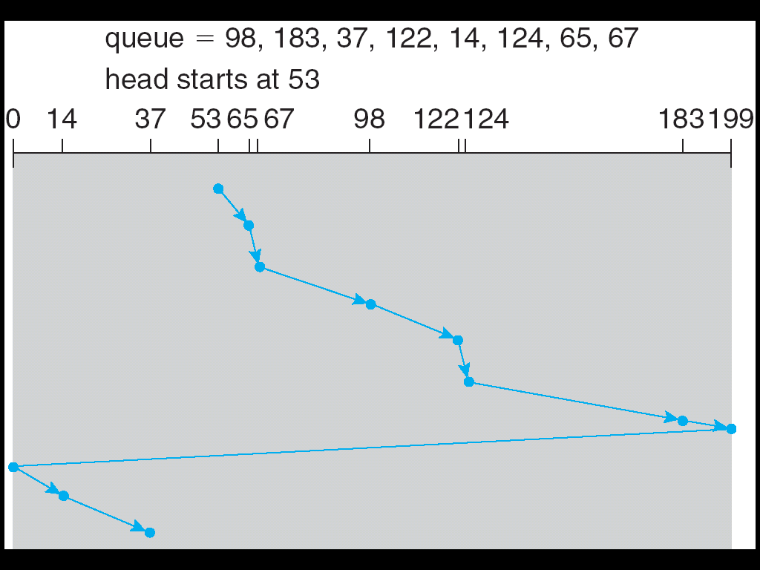
C-SCAN (Cont.)
Notes:
70

Slide 18
C-LOOK
LOOK a version of SCAN, C-LOOK a version of C-SCAN
Arm only goes as far as the last request in each direction, then reverses direction immediately, without first going all the way to the end of the disk
Notes:
70

Slide 19
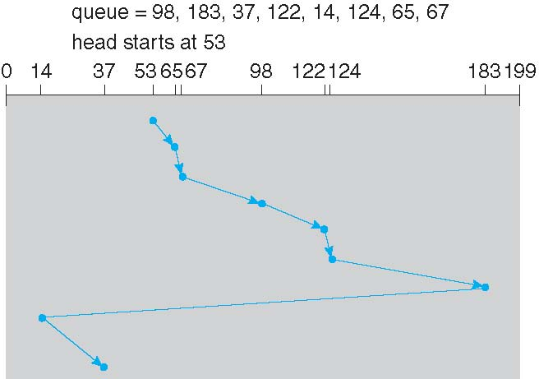
C-LOOK (Cont.)
Notes:
70

Slide 20
Selecting a Disk-Scheduling Algorithm
SSTF is common
SCAN and C-SCAN perform better for systems that place a heavy load on the disk
Less starvation
Performance depends on the number and types of requests
Requests for disk service can be influenced by the file-allocation method
A program reading a contiguously allocated file will generate several requests that are close together on the disk, resulting in limited head movement.
Notes:
70

Slide 21
Selecting a Disk-Scheduling Algorithm
A linked or indexed file may include blocks that are widely scattered on the disk, resulting in greater head movement.
The location of directories and index blocks is also important
Should be written as a separate module of the operating system, allowing it to be replaced with a different algorithm if necessary
Either SSTF or LOOK is a reasonable choice for the default algorithm
What about rotational latency?
Difficult for OS to calculate
SSDs use FCFS

Slide 22
Disk Management
Low-level formatting, or physical formatting — Dividing a disk into sectors that the disk controller can read and write
Each sector can hold header information, plus data, plus error correction code (ECC)
Usually 512 bytes of data but can be selectable
Notes:
70

Slide 23
Disk Management
To use a disk to hold files, the operating system still needs to record its own data structures on the disk
Partition the disk into one or more groups of cylinders, each treated as a logical disk
Logical formatting or “making a file system”
To increase efficiency most file systems group blocks into clusters
Disk I/O done in blocks
File I/O done in clusters

Slide 24
Disk Management (Cont.)
Raw disk access for apps that want to do their own block management, keep OS out of the way (databases for example)
Boot block initializes system
The bootstrap is stored in ROM
Bootstrap loader program stored in boot blocks of boot partition
Methods such as sector sparing used to handle bad blocks
Notes:
70

Slide 25
Swap-Space Management
Swap-space management is low-level task of the operating system.
Virtual memory uses disk space as an extension of main memory.
Since disk access is much slower than memory access, using swap space significantly decreases system performance.
The main goal for the design and implementation of swap space is to provide the best throughput for the virtual memory system

Slide 26
Swap-Space Management
Systems that implement swapping may use swap space to hold an entire process image, including the code and data segments.
Paging systems may simply store pages that have been pushed out of main memory.
Amount of swap space needed on a system can vary from a few megabytes of disk space to gigabytes, depending on the amount of physical memory, the amount of virtual memory it is backing, and the way in which the virtual memory is used

Slide 27
Swap-Space Storage Manager
Swap-space — Virtual memory uses disk space as an extension of main memory
Less common now due to memory capacity increases
Swap-space can be carved out of the normal file system, or, more commonly, it can be in a separate disk partition (raw partition)
No file system or directory structure is placed in this space.
A separate swap-space storage manager is used to allocate and deallocate the blocks from the raw partition.
Notes:
70

Slide 28
Swap-Space Storage Manager
This manager uses algorithms optimized for speed rather than for storage efficiency, because swap space is accessed much more frequently than file systems (when it is used).
Internal fragmentation may increase, but this trade-off is acceptable because the life of data in the swap space generally is much shorter than that of files in the file system.
Since swap space is reinitialized at boot time, any fragmentation is short-lived.

Slide 29
Swap-space management
Unix 4.3BSD allocates swap space when process starts; holds text segment (the program) and data segment
Kernel uses swap maps to track swap-space use
Solaris 2 allocates swap space only when a dirty page is forced out of physical memory, not when the virtual memory page is first created
File data written to swap space until write to file system requested
Other dirty pages go to swap space due to no other home
Text segment pages thrown out and reread from the file system as needed

Slide 30
Data Structures for Swapping on Linux Systems
Notes:
70

Slide 31
RAID Structure
RAID – redundant array of independent disks
multiple disk drives provides reliability via redundancy
Failure of one disk does not lead to loss of data.
Now collectively called redundant arrays of independent disks (RAID)
Increases the mean time to failure
Mean time to repair – exposure time when another failure could cause data loss
Mean time to data loss based on above factors
Several improvements in disk-use techniques involve the use of multiple disks working cooperatively
Notes:
70

Slide 32
RAID (Cont.)
Disk striping uses a group of disks as one storage unit
RAID is arranged into six different levels
RAID schemes improve performance and improve the reliability of the storage system by storing redundant data
Mirroring or shadowing (RAID 1) keeps duplicate of each disk
Striped mirrors (RAID 1+0) or mirrored stripes (RAID 0+1) provides high performance and high reliability
Block interleaved parity (RAID 4, 5, 6) uses much less redundancy
RAID within a storage array can still fail if the array fails, so automatic k, replication of the data between arrays is common
Frequently, a small number of hot-spare disks are left unallocated, automatically replacing a failed disk and having data rebuilt onto them
Notes:
70

Slide 33
RAID Levels
Notes:
70

Slide 34
RAID 4
Consists of block-level striping with dedicated parity
Disk1 Disk2 Disk3 Disk4
------- ------- ------- -------
data1 data1 data1 parity1
data2 data2 data2 parity2
data3 data3 data3 parity3
data4 data4 data4 parity4

Slide 35
RAID 5
Consists of block-level striping with distributed parity
Disk1 Disk2 Disk3 Disk4
------- ------- ------- -------
parity1 data1 data1 data1
data2 parity2 data2 data2
data3 data3 parity3 data3
data4 data4 data4 parity4
Notes:
35

Slide 36
RAID 6
Consists of block-level striping with double distributed parity.
Double parity provides fault tolerance up to two failed drives.

Slide 37
RAID (0 + 1) and (1 + 0)
Mirror of Stripes
Stripe of Mirrors
Notes:
35

Slide 38
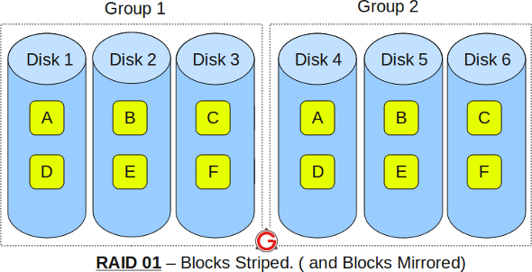
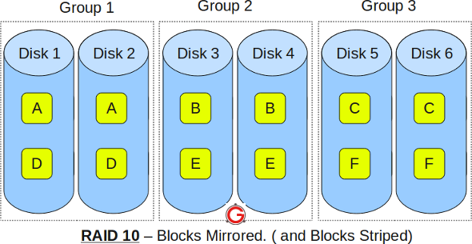
RAID 01 vs RAID 10
Mirror of Stripes
Stripe of Mirrors

Slide 39
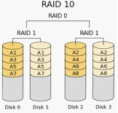

Slide 40
Other Features
Snapshot is a view of file system before a set of changes take place (i.e. at a point in time)
Replication is automatic duplication of writes between separate sites
For redundancy and disaster recovery
Can be synchronous or asynchronous
RAID decreases mean time to repair

Slide 41
RAID: Minimum number of drives
RAID 0 – 2
RAID 1 – 2
RAID 5 – 3
RAID 6 – 4
RAID 10 – 4

Slide 42
File System Implementation
Remaining Issues

Slide 43
File System Recovery
A system crash can cause inconsistencies among on-disk file-system data structures, such as directory structures, free-block pointers, and free FCB pointers
Changes in various data structures can be interrupted by a crash, resulting into inconsistencies among these structures.

Slide 44
File System Recovery
For example, the free FCB count might indicate that an FCB had been allocated, but the directory structure might not point to the FCB.
Some changes may go directly to disk, while others may be cached. If the cached changes do not reach disk before a crash occurs, more corruption is possible
Also, bugs in file-system implementation, disk controllers, and even user applications can also corrupt a file system

Slide 45
Consistency Checking
Using a scan of metadata
A file system can record its state within the file-system metadata.
At the start of any metadata change, a status bit is set to indicate that the metadata is in flux.
If all updates to the metadata complete successfully, the file system can clear that bit.
If, however, the status bit remains set, a consistency checker is run

Slide 46
Consistency Checker
Compares the data in directory structure with the data blocks on disk and tries to fix any inconsistencies it finds
Allocation and free-space management algorithms dictate what types of problems the checker can find and how successful it will be in fixing them
Linked allocation, Directory structure problem
Indexed allocation

Slide 47
Filesystem Hierarchy Standard (FHS) Document
Find unclean system shutdown
fsck needs to run over all inodes of the file system to ascertain which inodes and blocks are in use and to correct the bitmaps
Check the superblock
Check indirect, double indirect blocks etc.
If there is any inconsistency between bitmaps and inodes, it is resolved by trusting the information within the inodes.
The same type of check is performed for all the inodes, making sure that all inodes that look like they are in use are marked as such in the inode bitmaps

Slide 48
Log Structured File Systems
Log structured (or journaling) file systems record each metadata update to the file system as a transaction
All transactions are written to a log
A transaction is considered committed once it is written to the log (sequentially)
Sometimes to a separate device or section of the disk
However, the file system may not yet be updated
Also called write-ahead logging
Linux ext3 and ext4, reiserfs, IBM’s JFS, SGI’s XFS, and Windows NTFS
Notes:
35

Slide 49
Log Structured File Systems …
When updating the disk, before overwriting the structures in place, first write down a little note (somewhere else on the disk, in a well-known location) describing what you are about to do.
Writing this note is the “write ahead” part, and we write it to a structure that we organize as a “log”; (Write-ahead logging)
So, if crash takes place during update of structures, look into the logs and try again.
As the changes are made, a pointer is updated to indicate which actions have completed and which are still incomplete

Slide 50
Log Structured File Systems …
The transactions in the log are asynchronously written to the file system structures
When the file system structures are modified, the transaction is removed from the log
If the file system crashes, all remaining transactions in the log must still be performed
A circular buffer writes to the end of its space and then continues at the beginning, overwriting older values as it goes
If the system crashes, the log file will contain zero or more transactions
The transactions can be executed from the pointer until the work is complete

Slide 51
Log Structured File Systems …
When a transaction is aborted i.e. not committed before the system crashed:
Any changes that were applied to the file system must be undone, again preserving the consistency of the file system.
Faster recovery from crash, removes chance of inconsistency of metadata

Slide 52
Protocol to Update File System
Journal write: Write the contents of the transaction to the log; wait for these writes to complete
Journal commit: Write the transaction commit block to the log; wait for write to complete; transaction is said to be committed
Checkpoint: Write the contents of the update (metadata and data) to their final on-disk locations

Slide 53
Recovery
If the crash happens after the transaction has committed to the log, but before the checkpoint is complete, the file system can recover the update.
When the system boots, the file system recovery process will scan the log and look for transactions that have committed to the disk; these transactions are thus replayed (in order), with the file system again attempting to write out the blocks in the transaction to their final on-disk locations. (Known as Redo logging)
By recovering the committed transactions in the journal, the file system ensures that the on-disk structures are consistent, and thus can proceed by mounting the file system and readying itself for new requests

Slide 54
Backup Cycles
Backup is taken in cycles for restoring
Full Day Backup
Incremental Backup (Copy to another medium all files changed since Day zz)
…
Incremental Backup
Using this method, we can restore an entire disk by starting restores with the full backup and continuing through each of the incremental backups

Slide 55
The Sun Network File System (NFS)
An implementation and a specification of a software system for accessing remote files across LANs (or WANs)
The implementation is part of the Solaris and SunOS operating systems running on Sun workstations using an unreliable datagram protocol (UDP/IP protocol and Ethernet)
TCP may also be used
Notes:
35

Slide 56
NFS (Cont.)
Interconnected workstations viewed as a set of independent machines with independent file systems, which allows sharing among these file systems in a transparent manner
A remote directory is mounted over a local file system directory
The mounted directory looks like an integral subtree of the local file system, replacing the subtree descending from the local directory
Specification of the remote directory for the mount operation is nontransparent; the host name of the remote directory has to be provided
Files in the remote directory can then be accessed in a transparent manner
Notes:
35

Slide 57
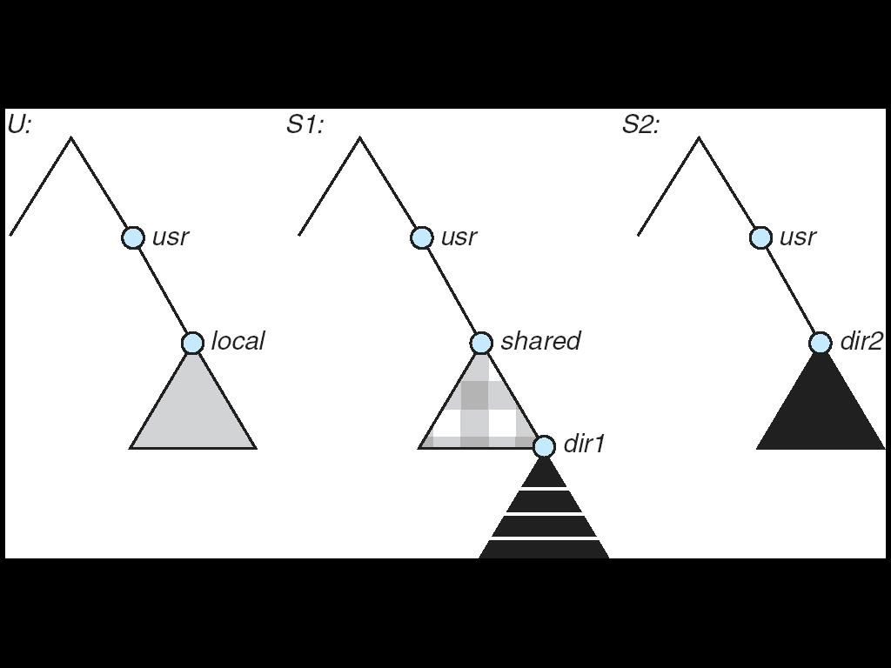
Subject to access-rights accreditation, potentially any file system (or directory within a file system), can be mounted remotely on top of any local directory

Slide 58
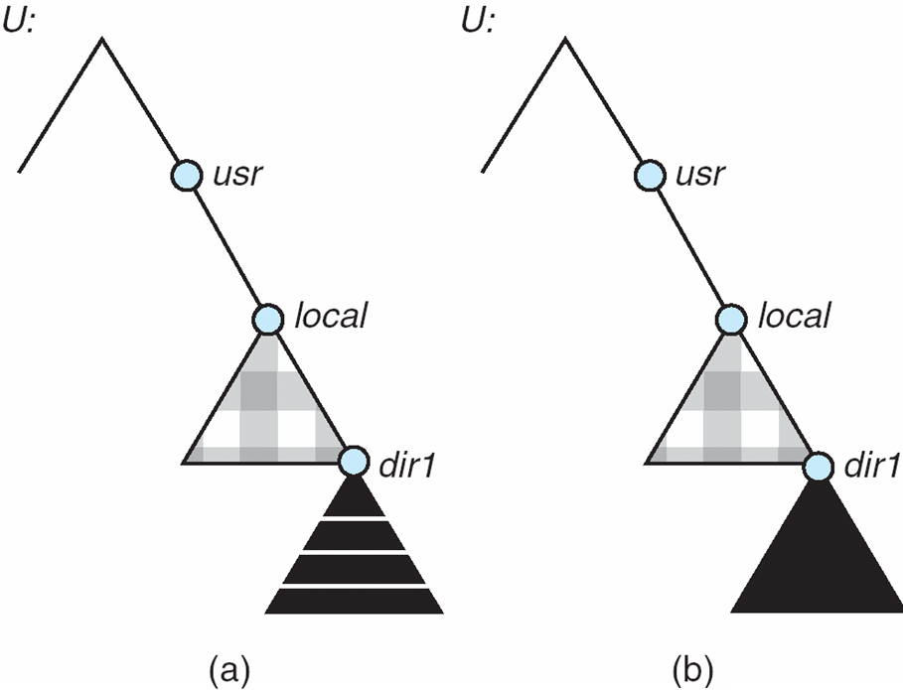
Mounting in NFS
Mounts
Cascading mounts
S1:/usr/shared over
U:/usr/local
S2:/usr/dir2 over U:/usr/local/dir1,which is already
remotely mounted from S1
Notes:
35

Slide 59
Mechanism of NFS Protocol
NFS operates in a heterogeneous environment of different machines, operating systems, and network architectures.
NFS specification independence is achieved through the use of RPC primitives built on top of an external data representation (XDR) protocol
Hence, if the system’s heterogeneous machines and file systems are properly interfaced to NFS, file systems of different types can be mounted both locally and remotely.

Slide 60
Mechanism of NFS Protocol
If the system’s heterogeneous machines and file systems are properly interfaced to NFS, file systems of different types can be mounted both locally and remotely
NFS specification distinguishes between the services provided by a mount mechanism and the actual remote-file-access services

Slide 61
Mechanism of NFS Protocol
Two separate protocols are specified for the mounting and remote file access services
A mount protocol and
A protocol for remote file accesses, the NFS protocol.
The protocols are specified as sets of RPCs.
These RPCs are the building blocks used to implement transparent remote file access

Slide 62
NFS Mount Protocol
Establishes initial logical connection between server and client
Mount operation includes name of remote directory to be mounted and name of server machine storing it
Mount request is mapped to corresponding RPC and forwarded to mount server running on server machine
Export list – specifies local file systems that server exports for mounting, along with names of machines that are permitted to mount them
e.g. in the file /etc/vfstab
A process
Notes:
35

Slide 63
NFS Mount Protocol
The server also maintains a list of the client machines and the corresponding currently mounted directories
A system has a static mounting preconfiguration that is established at boot time; however, this layout can be modified
The mount operation changes only the user’s view and does not affect the server side

Slide 64
NFS Protocol
NFS protocol provides a set of RPCs for remote file operations.
The procedures support the following operations:
Searching for a file within a directory
Reading a set of directory entries
Manipulating links and directories
Accessing file attributes
Reading and writing files
These procedures can be invoked only after a file handle for the remotely mounted directory has been established after following a mount request that conforms to its export list

Slide 65
NFS Protocol
File handle – a file-system identifier, and an inode number to identify the mounted directory within the exported file system
NFS servers is that they are stateless.
Servers do not maintain information about their clients from one access to another
Each server request has to provide a full set of arguments
Client list maintained at the servers is not essential for the correct operation of the client or the server, and hence it does not need to be restored after a server crash

Slide 66
NFS Protocol
Directory-name-lookup cache on the client side holds the vnodes for remote directory names
Modified data must be committed to the server’s disk before results are returned to the client.
In case of server crash recovery will be invisible to a client
What about cached data at the client?
Further, a single NFS write procedure call is guaranteed to be atomic

Slide 67
Three Major Layers of NFS Architecture
UNIX file-system interface (based on the open, read, write, and close calls, and file descriptors)
Virtual File System (VFS) layer – distinguishes local files from remote ones, and local files are further distinguished according to their file-system types
The VFS activates file-system-specific operations to handle local requests according to their file-system types
Calls the NFS protocol procedures for remote requests
NFS service layer – bottom layer of the architecture
Implements the NFS protocol
Notes:
<number>

Slide 68
Remote file handling
The client initiates the operation with a regular system call.
The operating-system layer maps this call to a VFS operation on the appropriate vnode.
The VFS layer identifies the file as a remote one and invokes the appropriate NFS procedure.
An RPC call is made to the NFS service layer at the remote server.
This call is reinjected to the VFS layer on the remote system, which finds that it is local and invokes the appropriate file-system operation.
This path is retraced to return the result

Slide 69
Path-name translation
Path-name translation is done by breaking the path into component names and performing a separate NFS lookup call for every pair of component name and directory vnode.
Once a mount point is crossed, every component lookup causes a separate RPC to the server.
When a client has a cascading mount, more than one server can be involved in a path-name traversal.

Slide 70
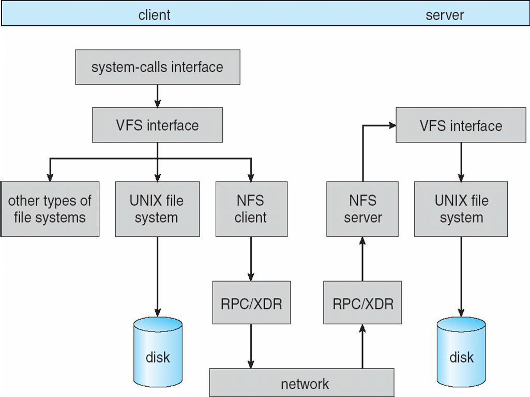
Schematic View of NFS Architecture
Notes:
<number>

